Slide 1

Life skills.
GRADE | 3 YEAR 2
TERM | 4
SUBJECT | Life skills

Slide 2
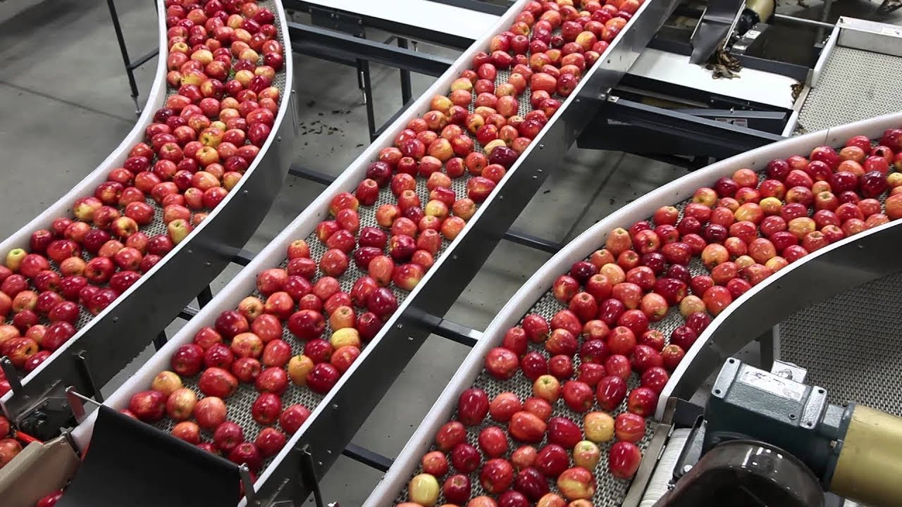
Products and processes

Slide 3
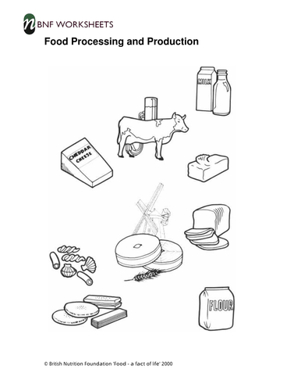
Products and processes
Group 1 learners are required to colour the products in the worksheet accordingly

Slide 4
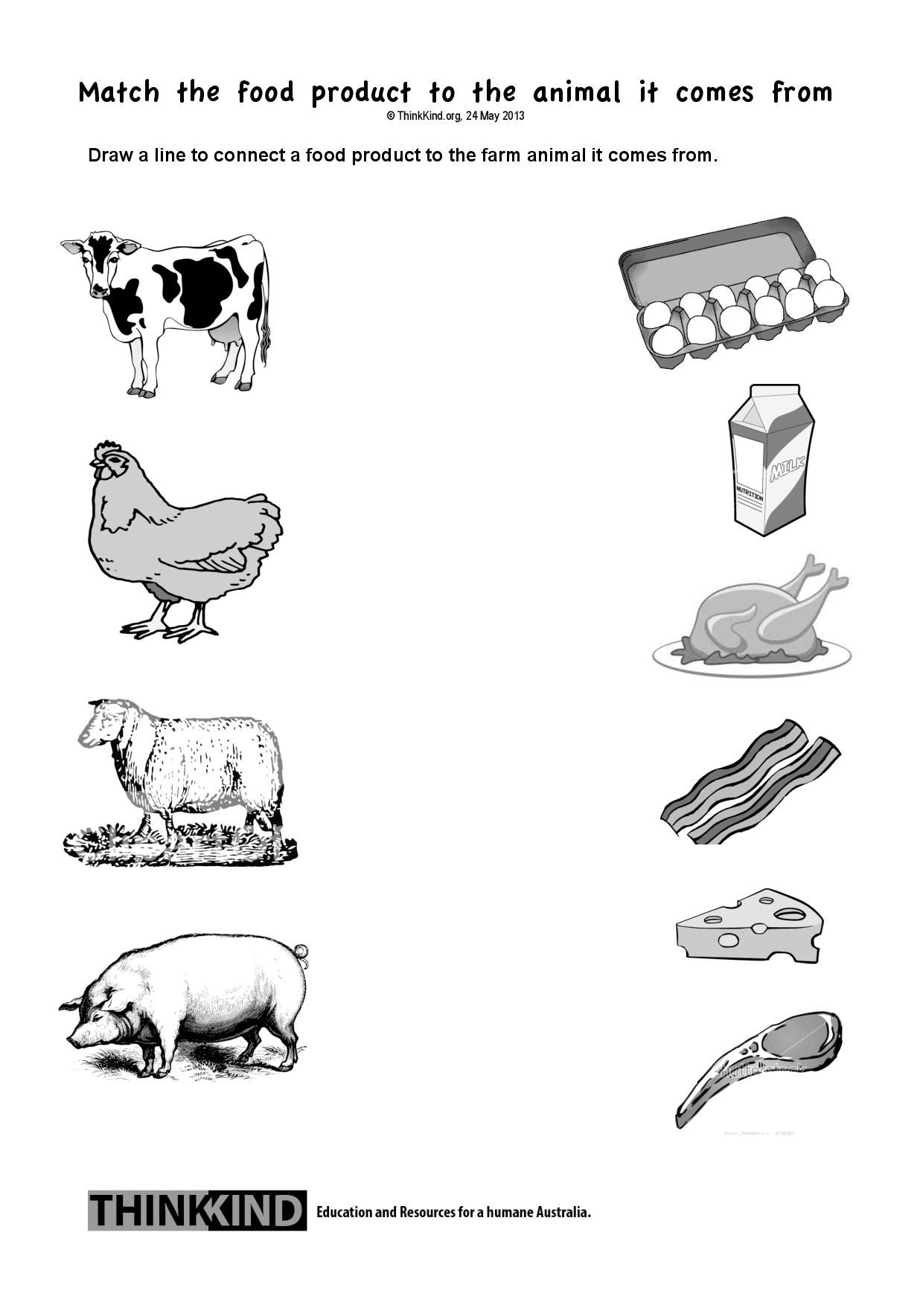
Products and processes group 2

Slide 5
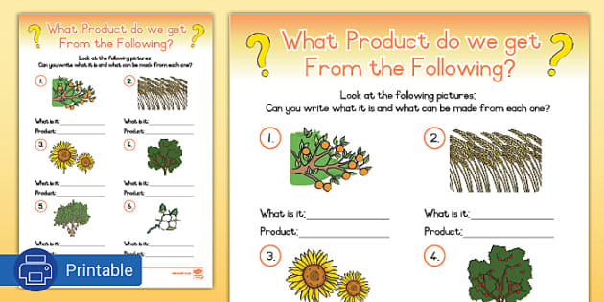
Products and processes
Group 3

Slide 6
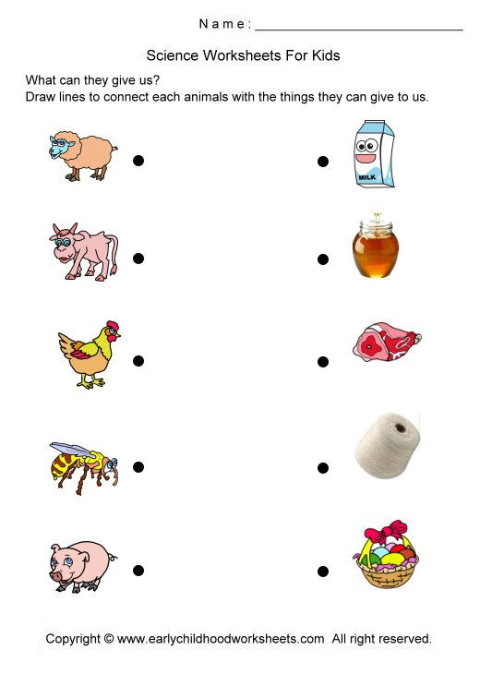
Animals that help us.
Group 1

Slide 7
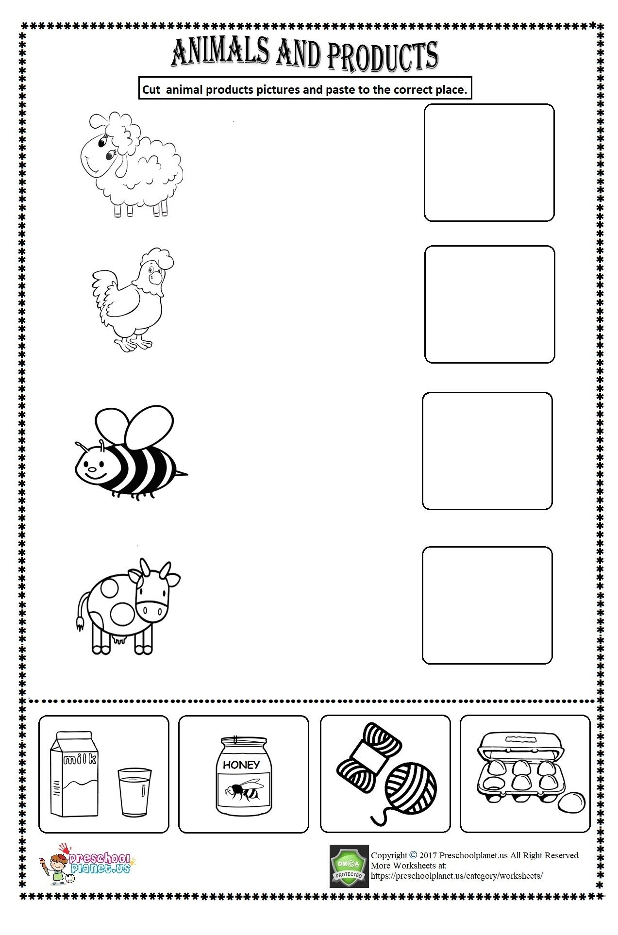
Animals that help us
Group 2 group 2

Slide 8
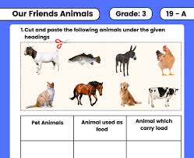
Animals that help us
Group 3

Slide 9
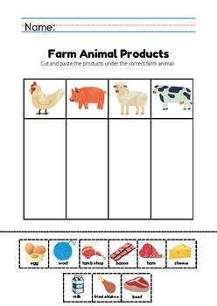
Animals that help us group 3

Slide 10
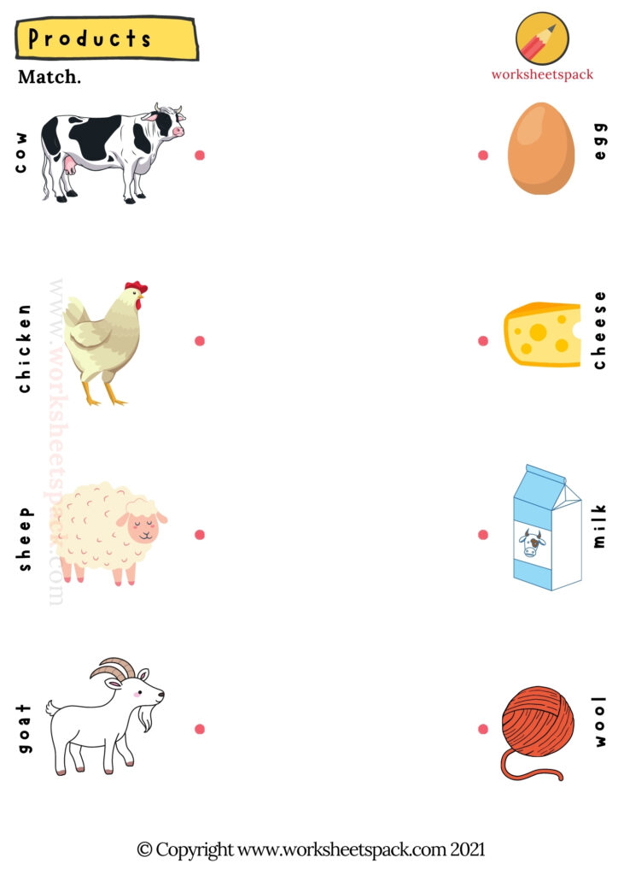
Animals that help us

Slide 11

World at work

Slide 12
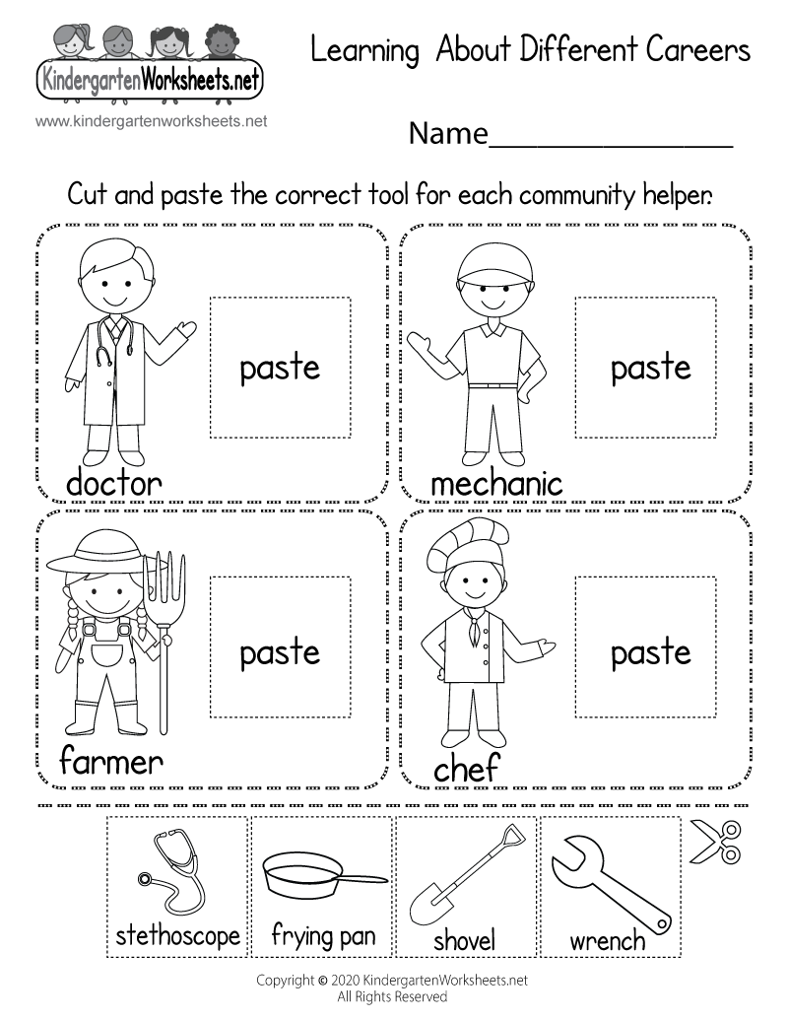
World at work group 1

Slide 13
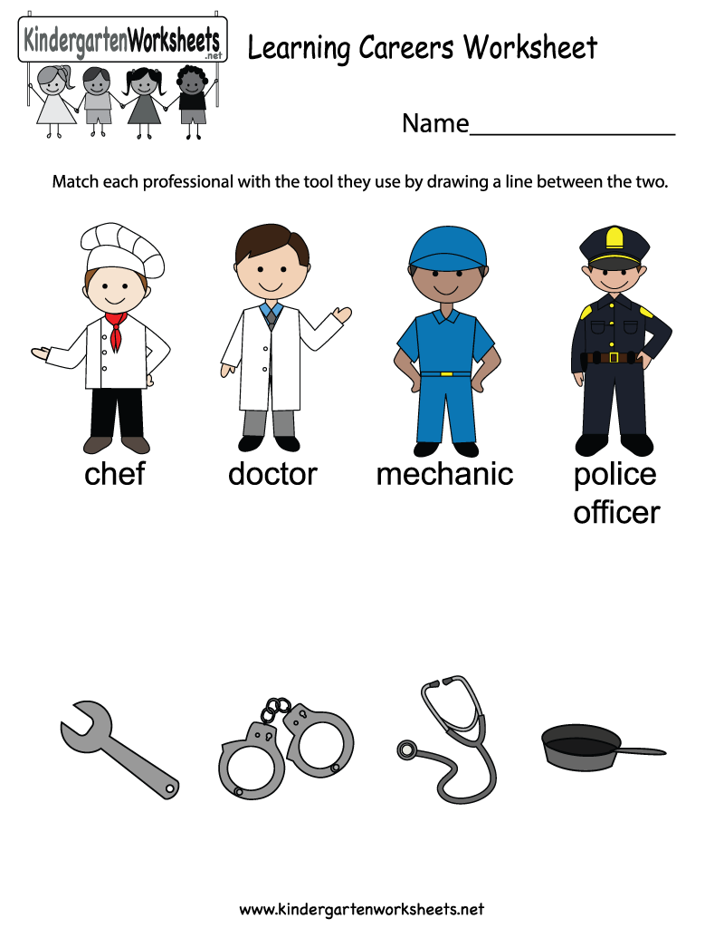
World at work group 2

Slide 14
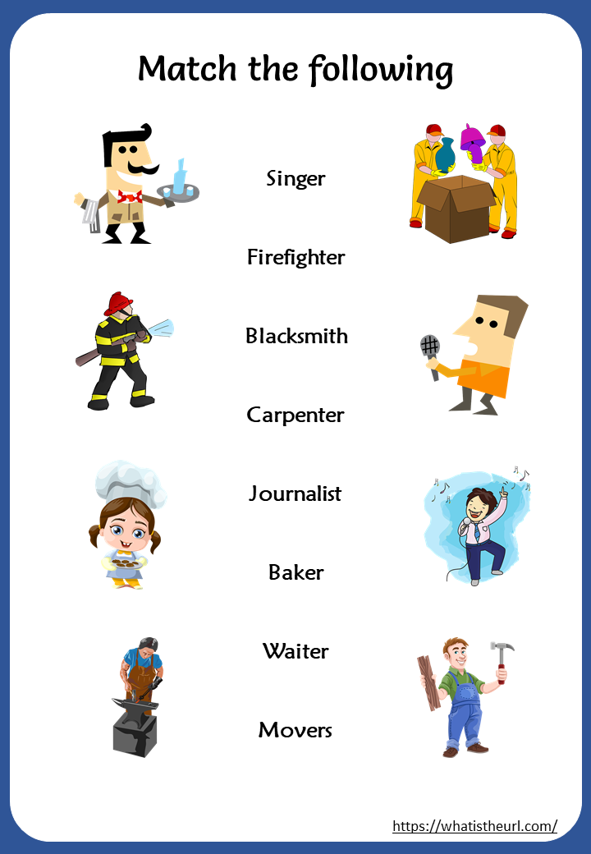
World aT work group 2

Slide 15
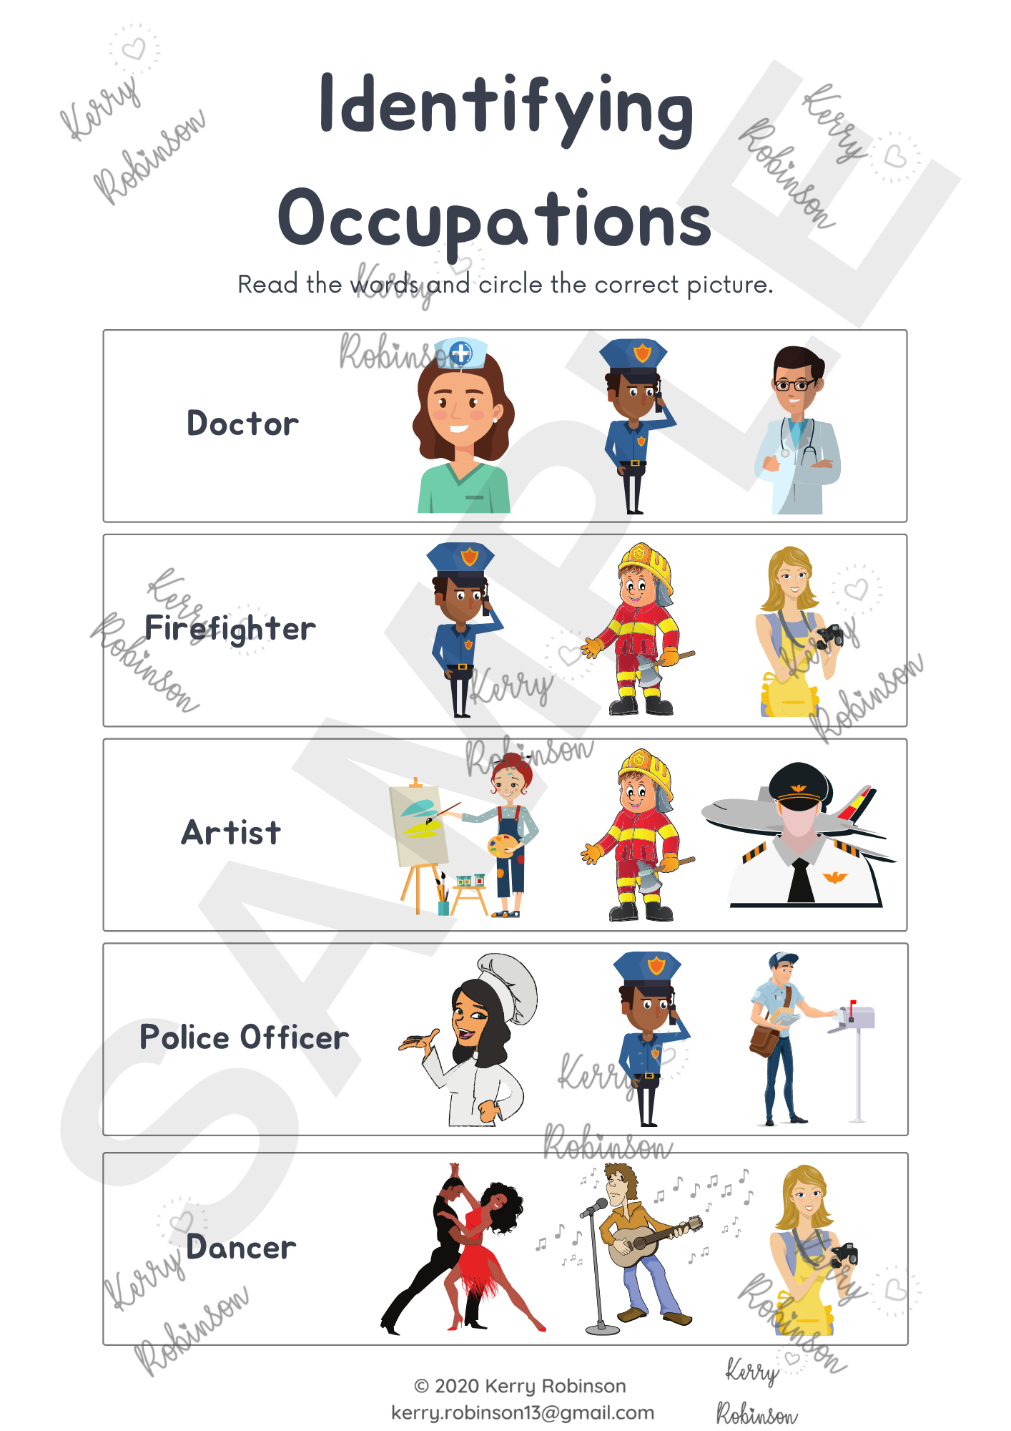
WORLD AT WORK
GROUP 3

Slide 16
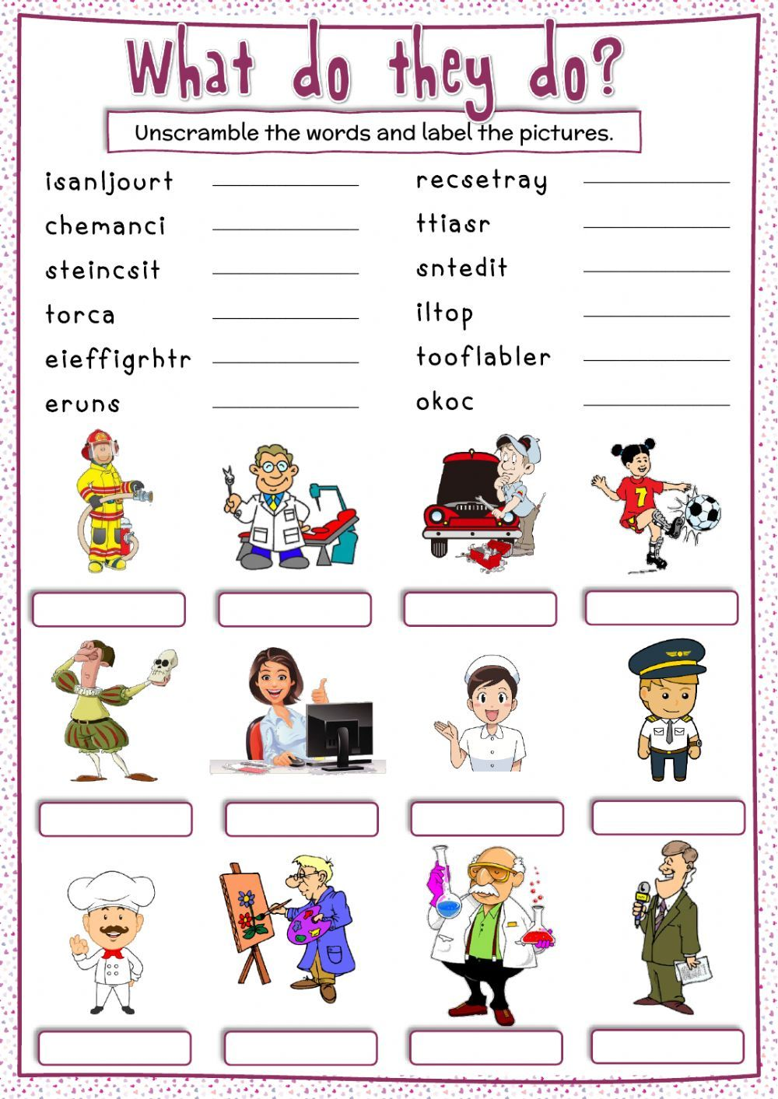
WORLD AT WORK
GROUP 3

Slide 17

I CAN BE AN ENTREPRENEUR

Slide 18

I CAN BE AN ENTREPENEUR
GROUP 1
Learners are required to complete the word search with high support and guidance from the teacher

Slide 19
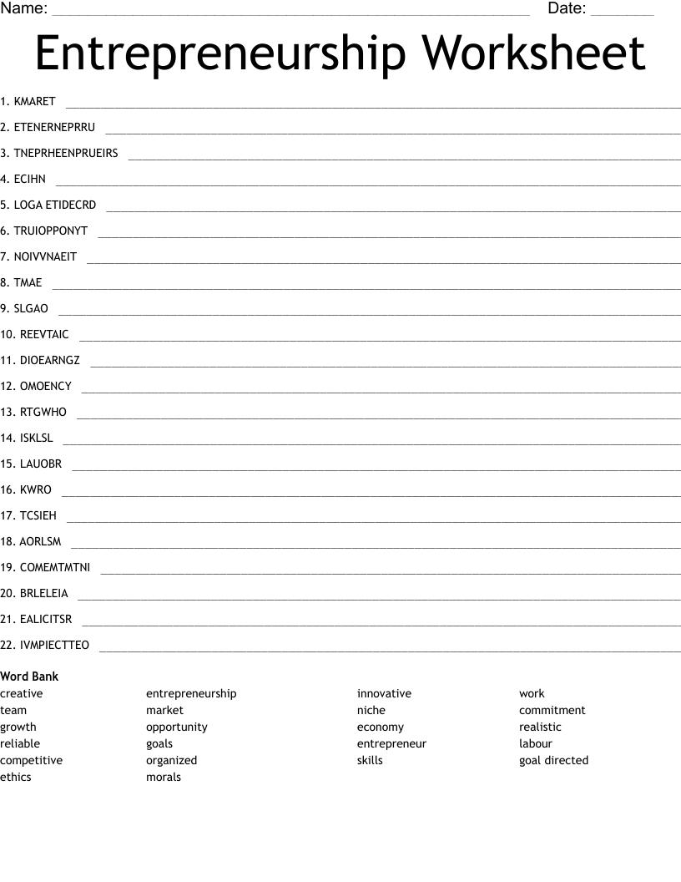
I CAN BE AN ENTREPRENEUR
GROUP 2

Slide 20
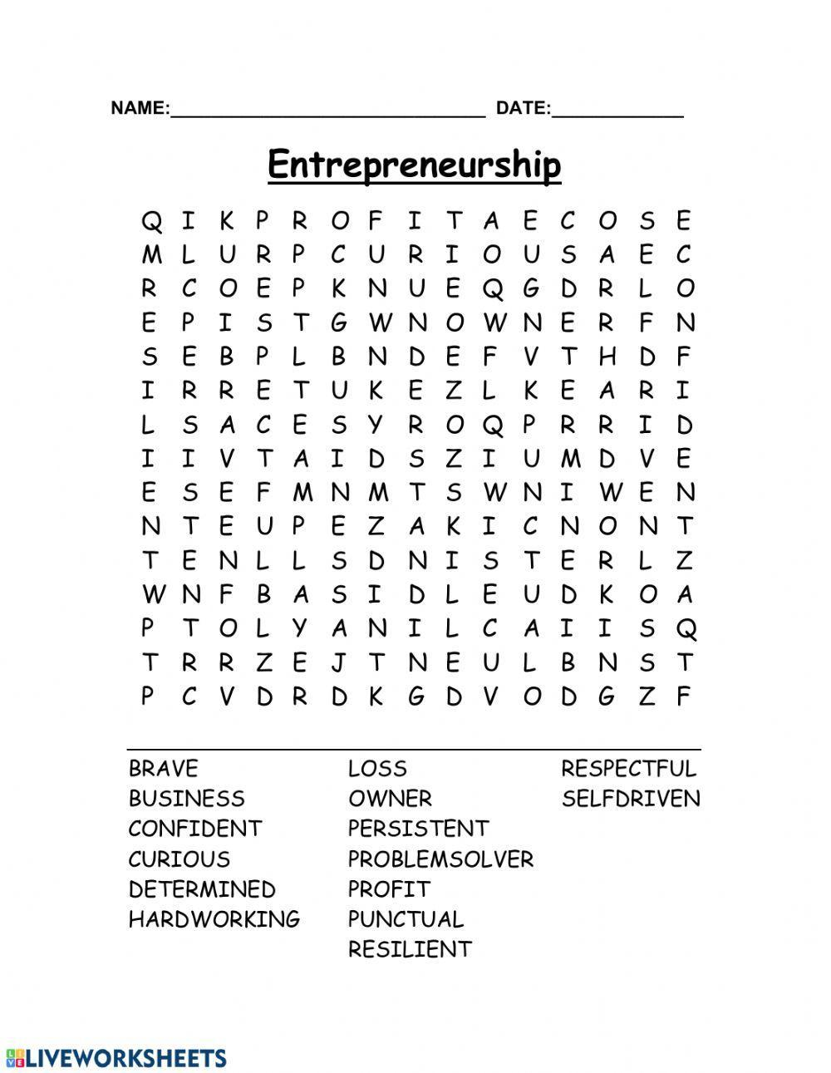
I CAN BE AN ENTREPENEUR
GROUP 2

Slide 21
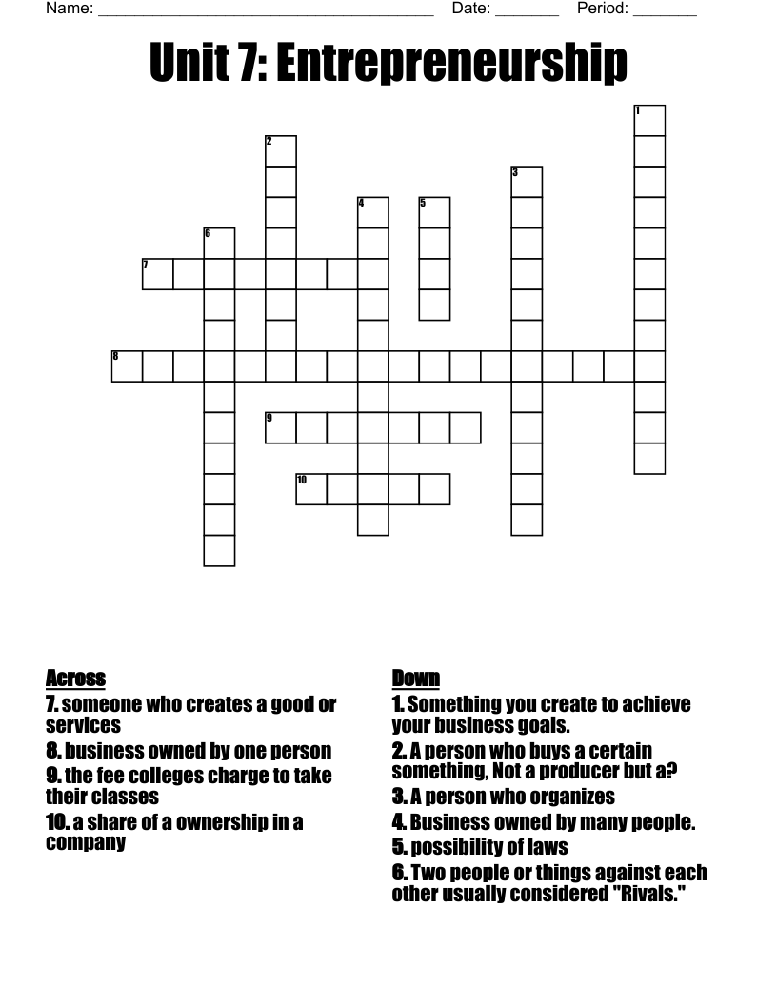
I CAN BE AN ENTREPRENEUR
GROUP 3

